Slide 1
GPA Calculator
Levi Emery & Jake Thornton

Slide 2
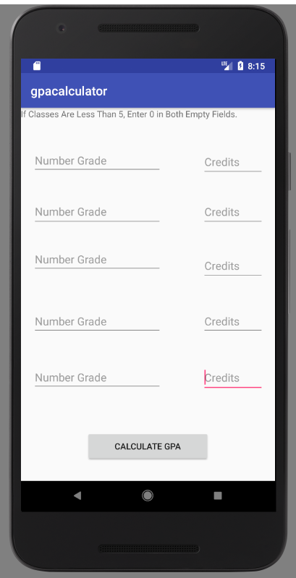
First Screen Front End
In the xml file there is a textview that appears on the top of the screen telling the user to enter 0’s if the field is empty. There also are 10 edittext fields created. They are all number fields. On the bottom of the screen there is a button that creates a new activity when pressed. We used constraint layout to structure the xml.

Slide 3
First Screen Back End
Most of the back end of the project takes place in the first activity java file. All of the edittext from the xml file are set to variables and then the number grades have to go through a loop to change them to the correct gpa equivalent. Then they are multiplied by the credits enter. After that they are all added and then divided by the total credit. This information is stored to be used in the next activity. These calculations are set to happen when the button is pressed. Then a new activity is created and shown on screen.

Slide 4
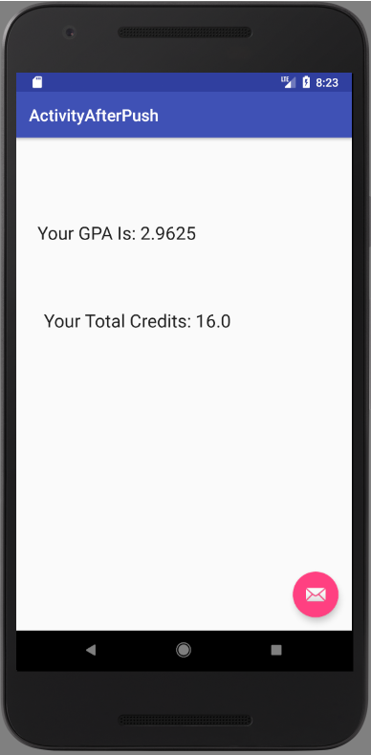
Second Screen Front End
For the second screen there is only two textviews that display the calculated gpa and the total number of credits entered. These fields are created in the java file using the information stored in the first activity.

Slide 5
Second Screen Back End
In the second activity java file the data stored from the calculations is called and stored to the textview fields in the second xml file.

